Slide 1
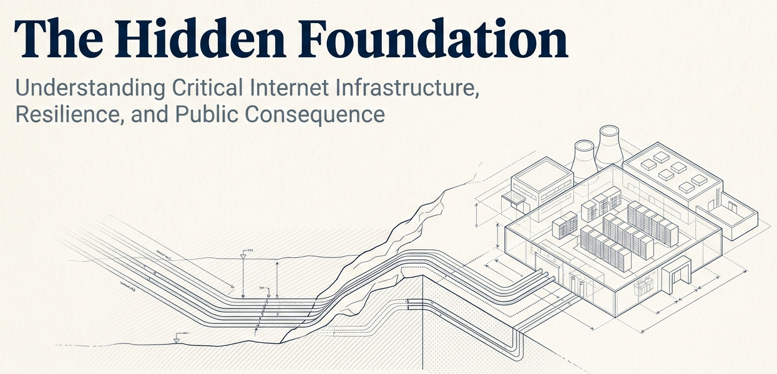

Notes:
The Internet has become foundational to economic activity, public services, institutional operations, communication, education, innovation and everyday life. Yet much of the infrastructure that makes this possible remains outside the direct view of the people and institutions that depend upon it.
This session makes that infrastructure visible.
It introduces Critical Internet Infrastructure through the relationship between capability, dependency and consequence; provides participants with a practical way to assess criticality; explains how resilience is created and sustained; and shows why infrastructure development requires engagement from a wider community than technical practitioners alone.
The session ultimately connects Critical Internet Infrastructure to Internet governance by demonstrating that its resilience is shaped through decisions about technology, investment, policy, regulation, research, institutional capability, security, coordination and public interest.

Slide 2
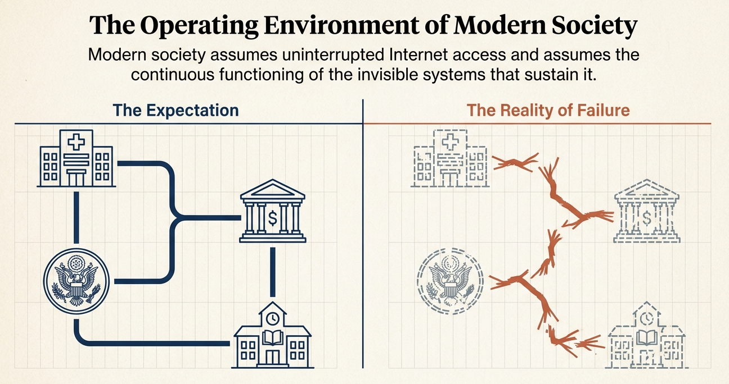


Notes:
Infrastructure becomes critical because important things depend upon it.
Here’s the flow:
The Internet enables capability.
Capability depends upon infrastructure.
Dependency creates criticality.
Criticality creates consequence.
Understanding criticality informs resilience.
Understanding creates agency.
Agency broadens participation.
Participation shapes investment, policy and development.
These are Internet governance choices.

Slide 3
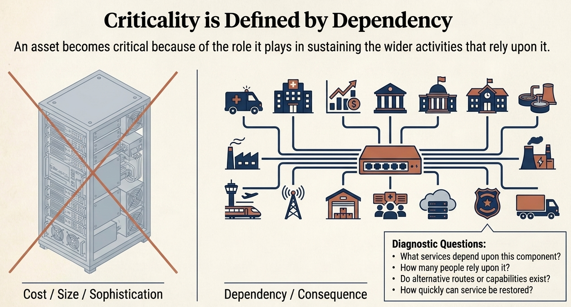
Notes:
Here’s the flow:
The Internet enables capability.
Capability depends upon infrastructure.
Dependency creates criticality.
Criticality creates consequence.

Slide 4
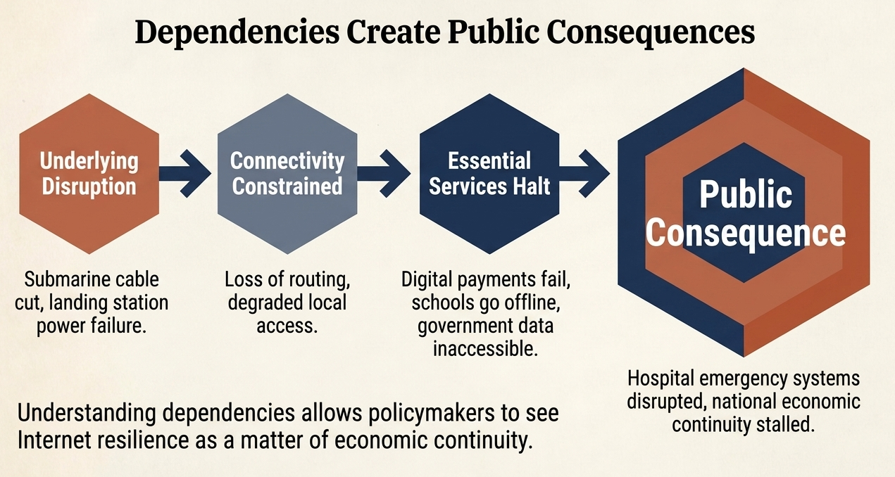

Slide 5
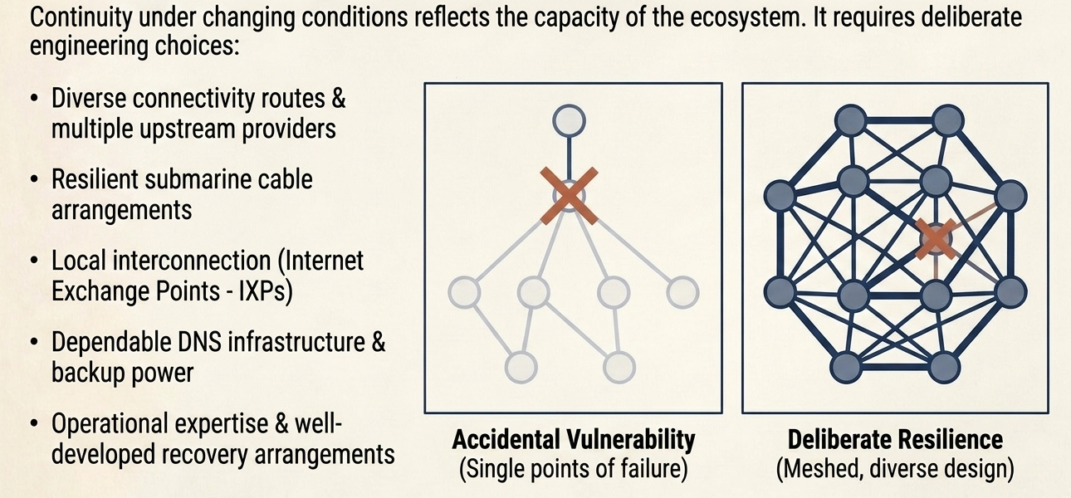
RESILIENCE IS BUILT…it does not emerge automatically

Slide 6
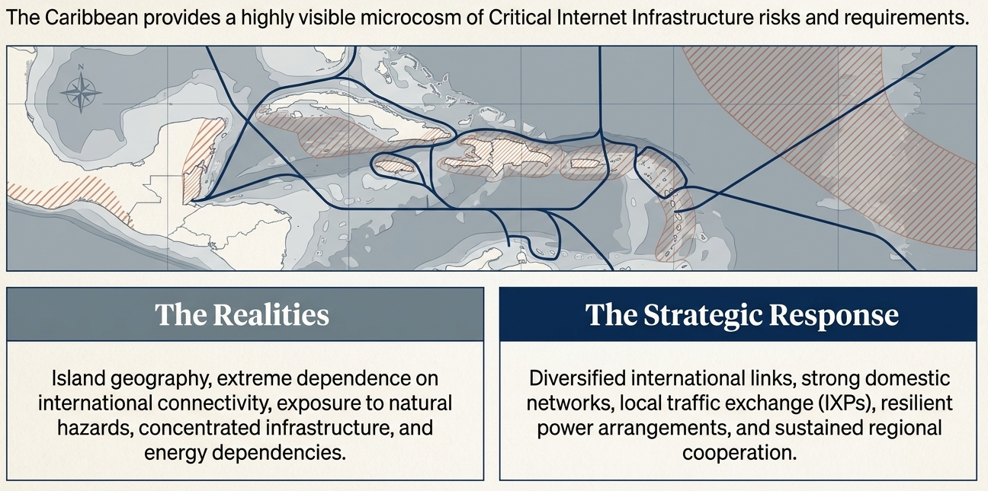
THE Caribbean Context: Geography Influences – Governance Determines …

Slide 7
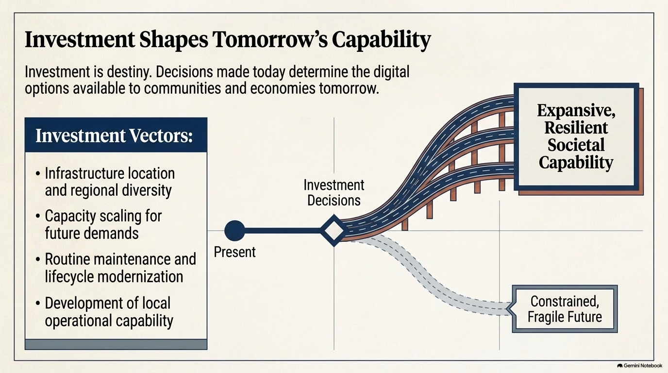

Slide 8
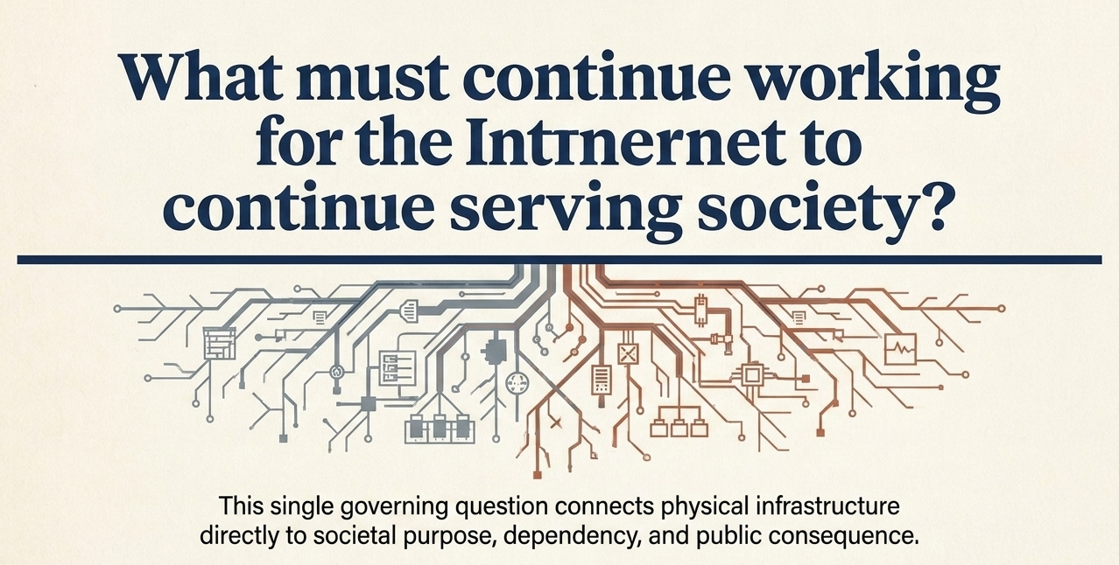
Notes:
Understanding criticality informs resilience.
Understanding creates agency.
Agency broadens participation.
Participation shapes investment, policy and development.
These are Internet governance choices.

Slide 9
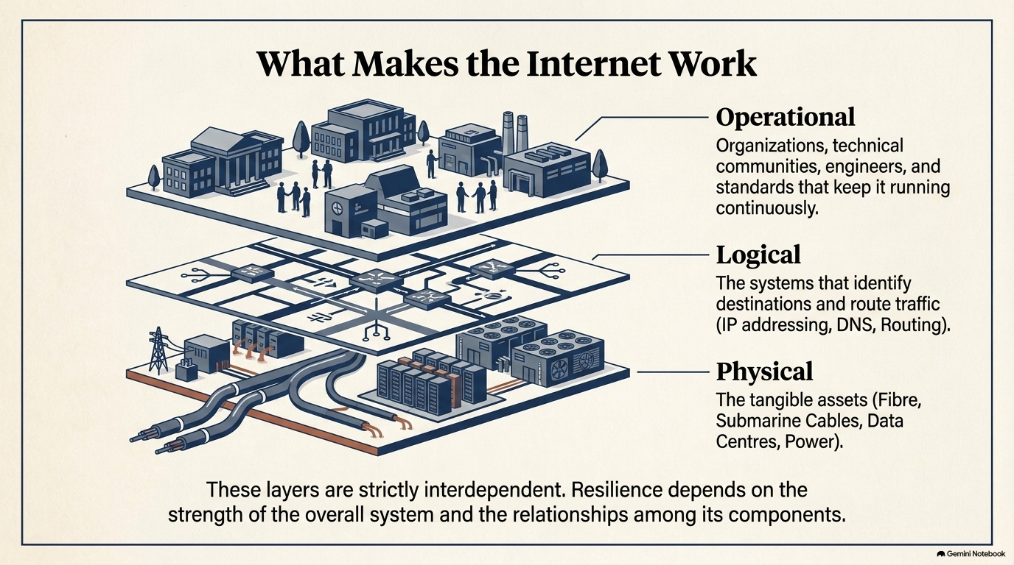
Notes:
The key Internet Organizations isoc, icann, arin, lacnic, ripe ncc. apnic, afrinic, NRO, IGF, WISIS, IANA

Slide 10
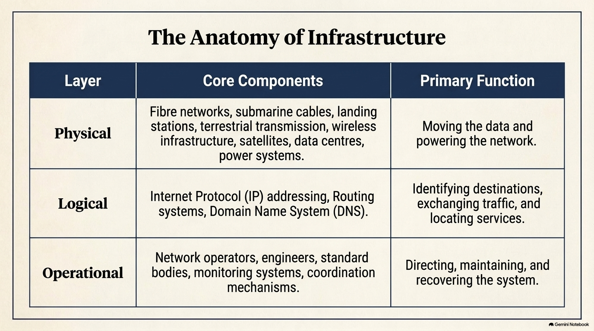

Slide 11
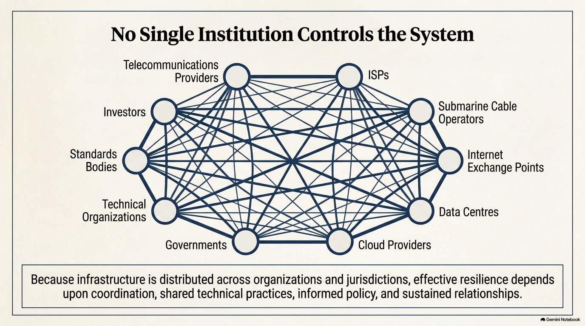

Slide 12
